Slide 1


USDA crop data & Price Forecasting
Kali Williams, Erin Nazetta, Joel Aponte and Onuwa Nwosu

Slide 2
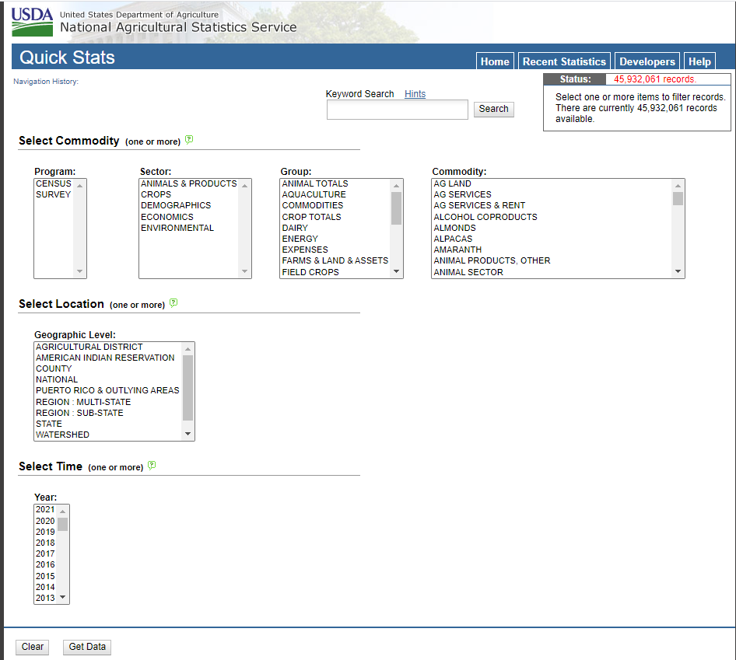
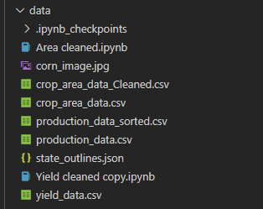
Visualizing USDA for crops - Data
Downloaded data for crops
Used pandas to clean
Used SQL and Flask

Slide 3
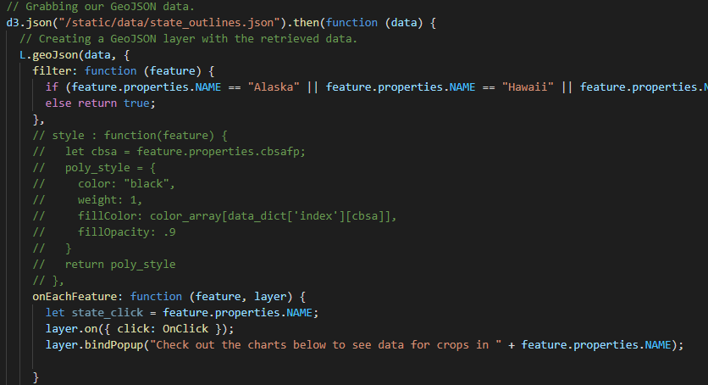
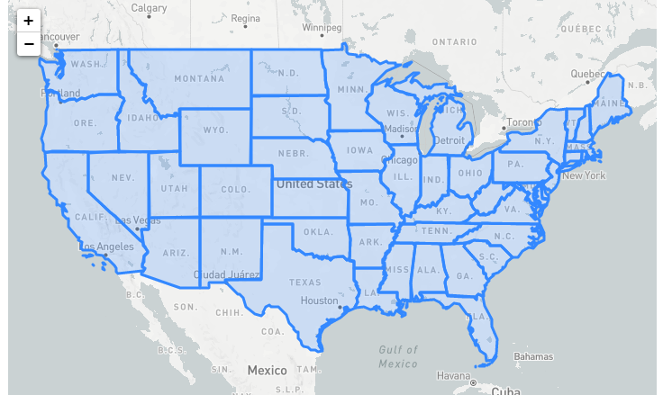
Creating the map
Adding a map
Creating state borders – using GeoJSON
Removed Alaska, Hawaii, Puerto Rico
Created feature click to output state name

Slide 4
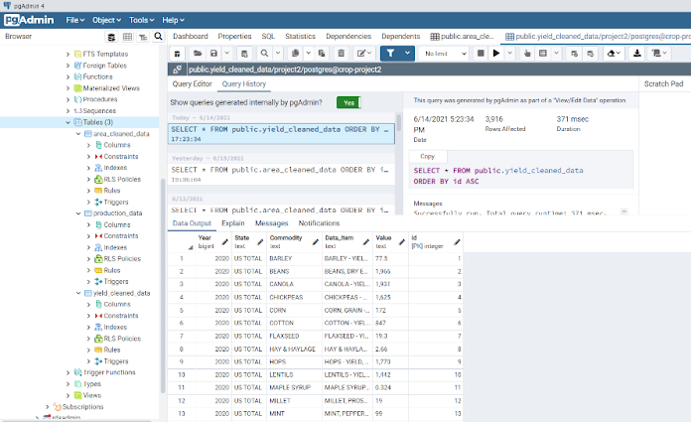
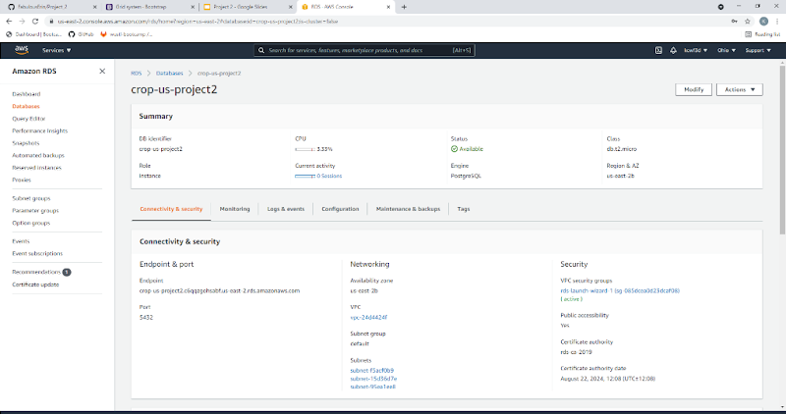
Database Connection
Cleaned Data with Jupyter Notebooks and created a postgres database with AWS connection

Slide 5
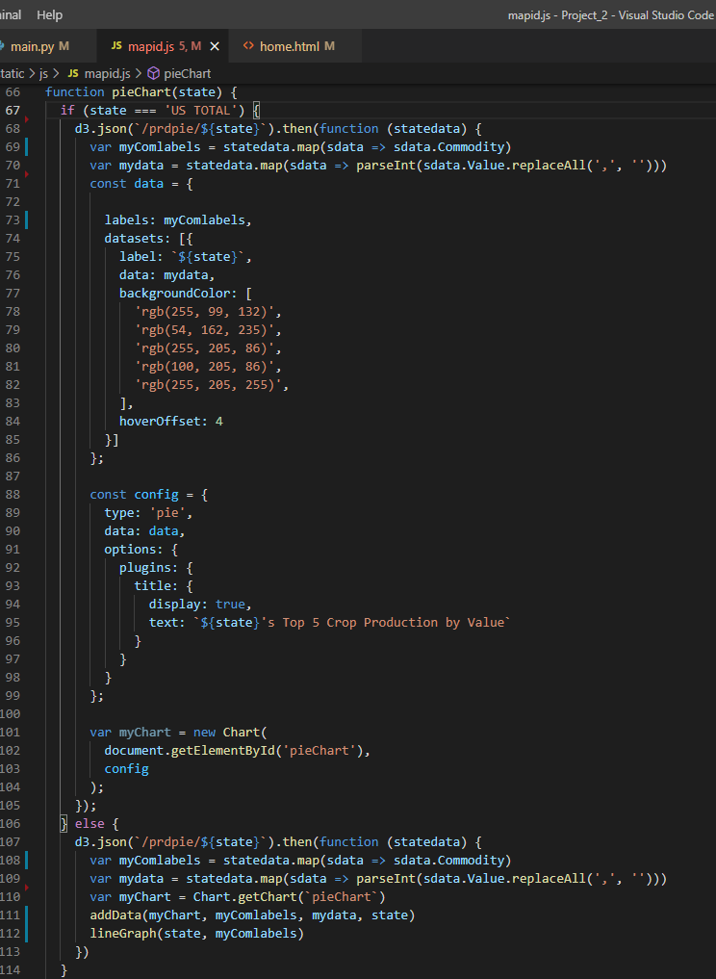
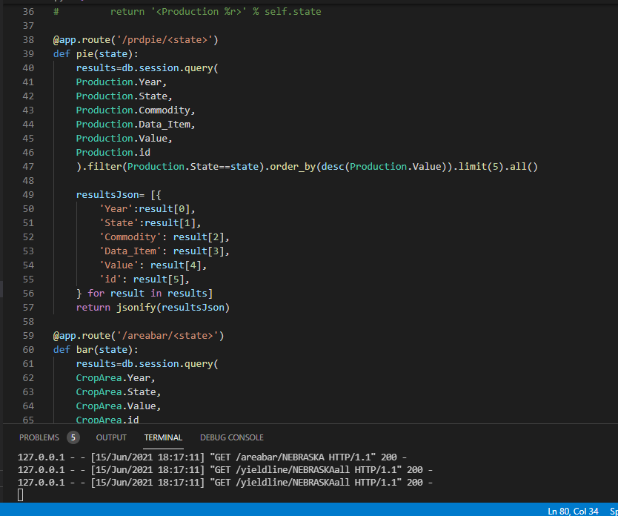
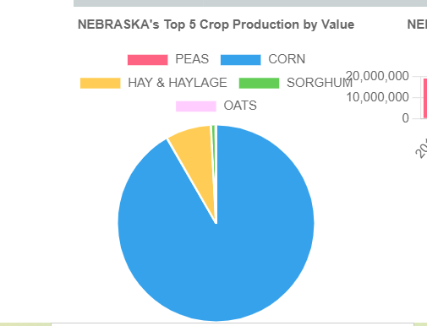
Graphs
Once you click on a particular state, the pie graph, bar chart and line graph will pull in the specific Production, Area and Yield data set, custom to each state.
Chart.js was used in creation of the graphs.

Slide 6
Final Project

Slide 7
JOEL: Price Data Cleaning and Organizing

Slide 8
ERIN: Data analysis & charting

Slide 9
KALI: Formatting & Deploying

